Slide 2
Sekisui Chemical Group
Global Hotline (GHL)- Guide for Externals

Slide 3
Sekisui Chemical Group – Global Hotline (GHL)
System Guide for Externals
System Interface
  for Whistleblower
  for Whistleblower Contact Office

Slide 4

GHL System Interface for Whistleblower
Two GHL sites are available
For Employees designed for current employees within the Sekisui Group.
For Externals designed for former employees, business partners and suppliers of the Sekisui Group.
PC: https://portal.dq-helpline.com/sekisui-supplier

Slide 5
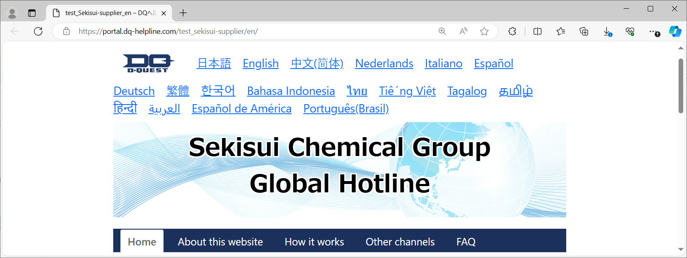
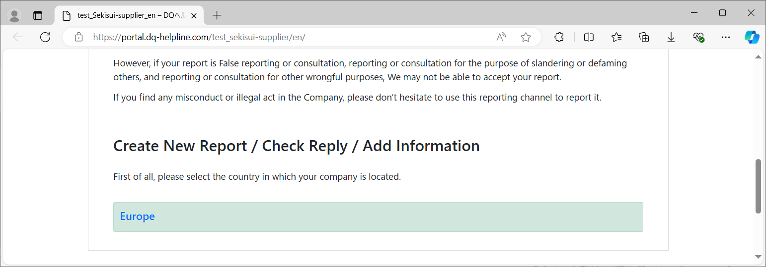
System Interface for Whistleblower - Externals
①Select Language
【18 languages】
English
German, Dutch, Italian, Spanish,
Chinese (Simplified), Chinese (Traditional), Korean, Thai, Vietnamese, Tamil,
Hindi, Indonesian, Arabic, Tagalog,
South American Spanish, South American, Portuguese, Japanese
<During the final check>
②Select the area where the whistleblower resides

Slide 6
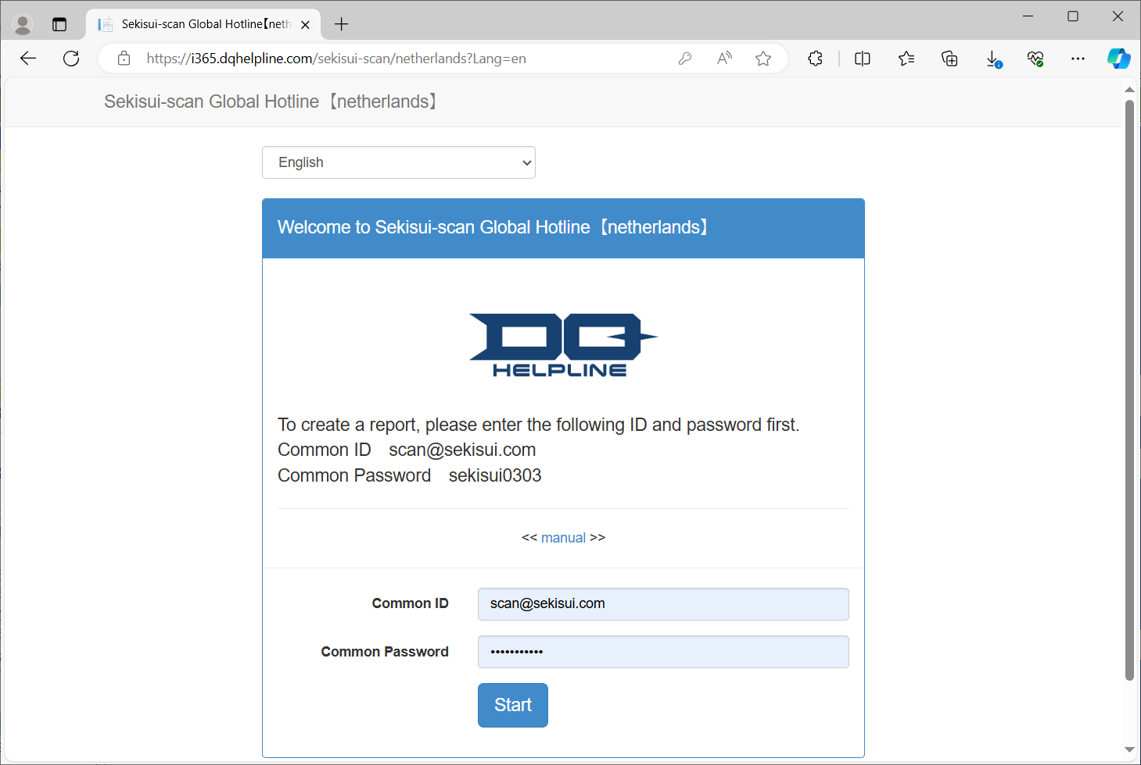
System Interface for Whistleblower - Externals
ID and password are common
ID sekisui
Password sekisui
Sekisui
Chemical
Group
Global
Hotline
policy
③Please copy and paste
ID and password into
the respective fields.
④Go to the next screen

Slide 7
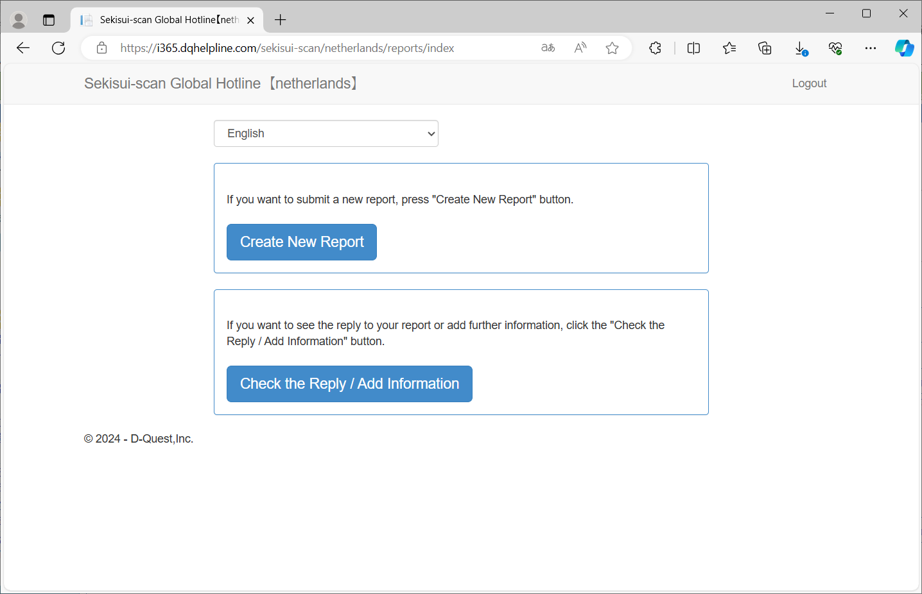
System Interface for Whistleblower - Externals
⑤Create a new report
To see the reply to your report
or add further information

Slide 8
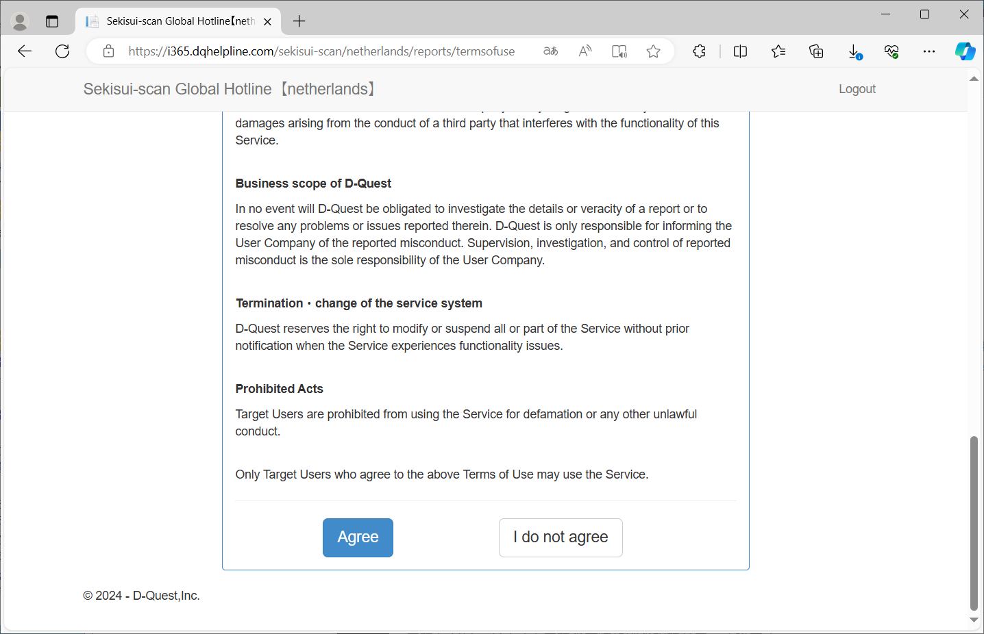
System Interface for Whistleblower - Externals
⑥Please read these Terms of Use
carefully before using this site.
Click “Agree” button if you
consent to Terms of Use.

Slide 9
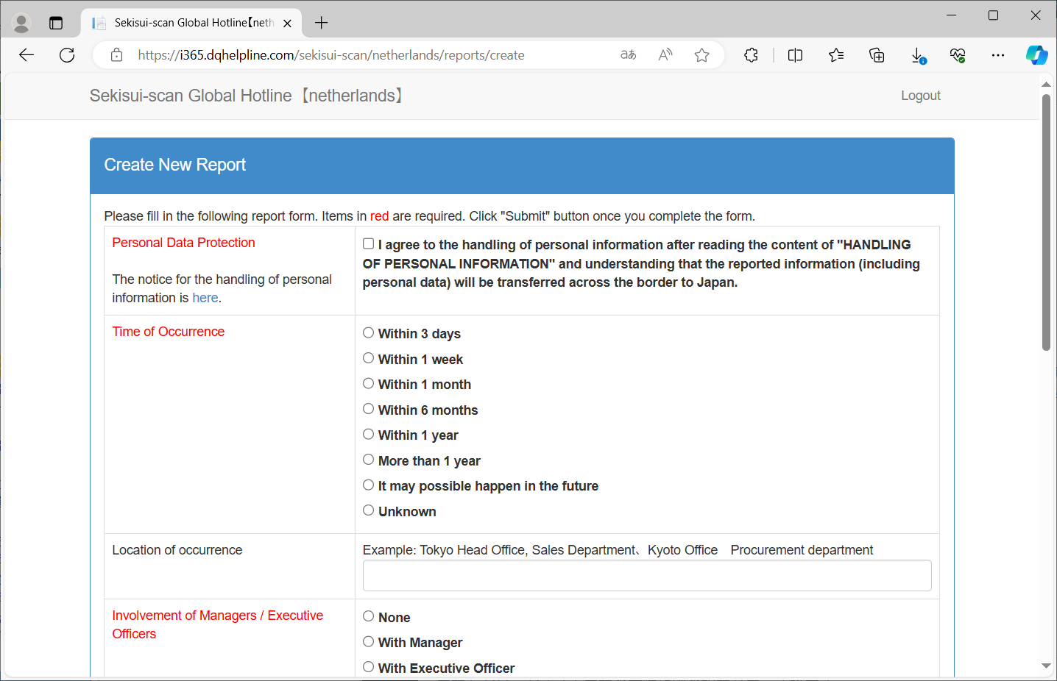
System Interface for Whistleblower - Externals
⑦Your report will be sent to the Whistleblowing
contact office of Sekisui Chemical, Japan, Ltd.
Please read the notice for the handling of personal
information and check here if you agree.

Slide 10
System Interface for Whistleblower - Externals
⑧When did this occur?

Slide 11
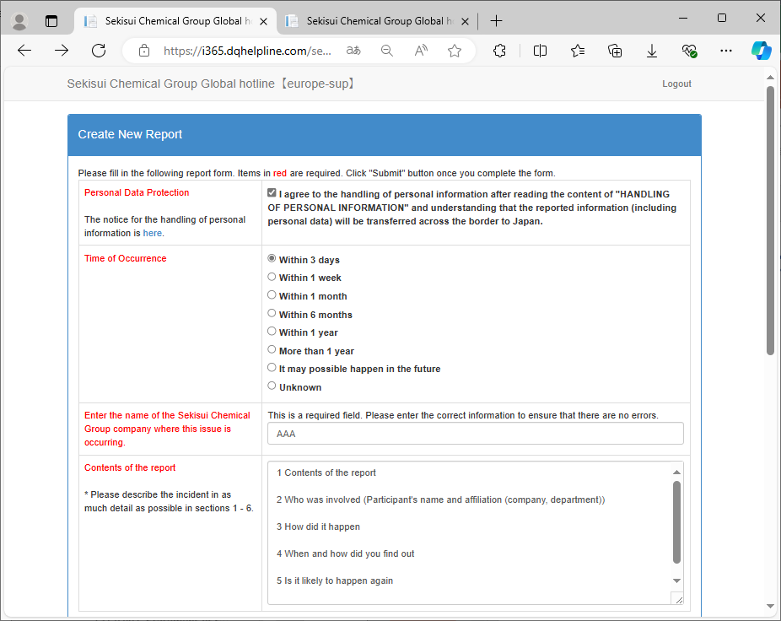
System Interface for Whistleblower - Externals
③The name of the company where the problem occurred is a required field.

Slide 12
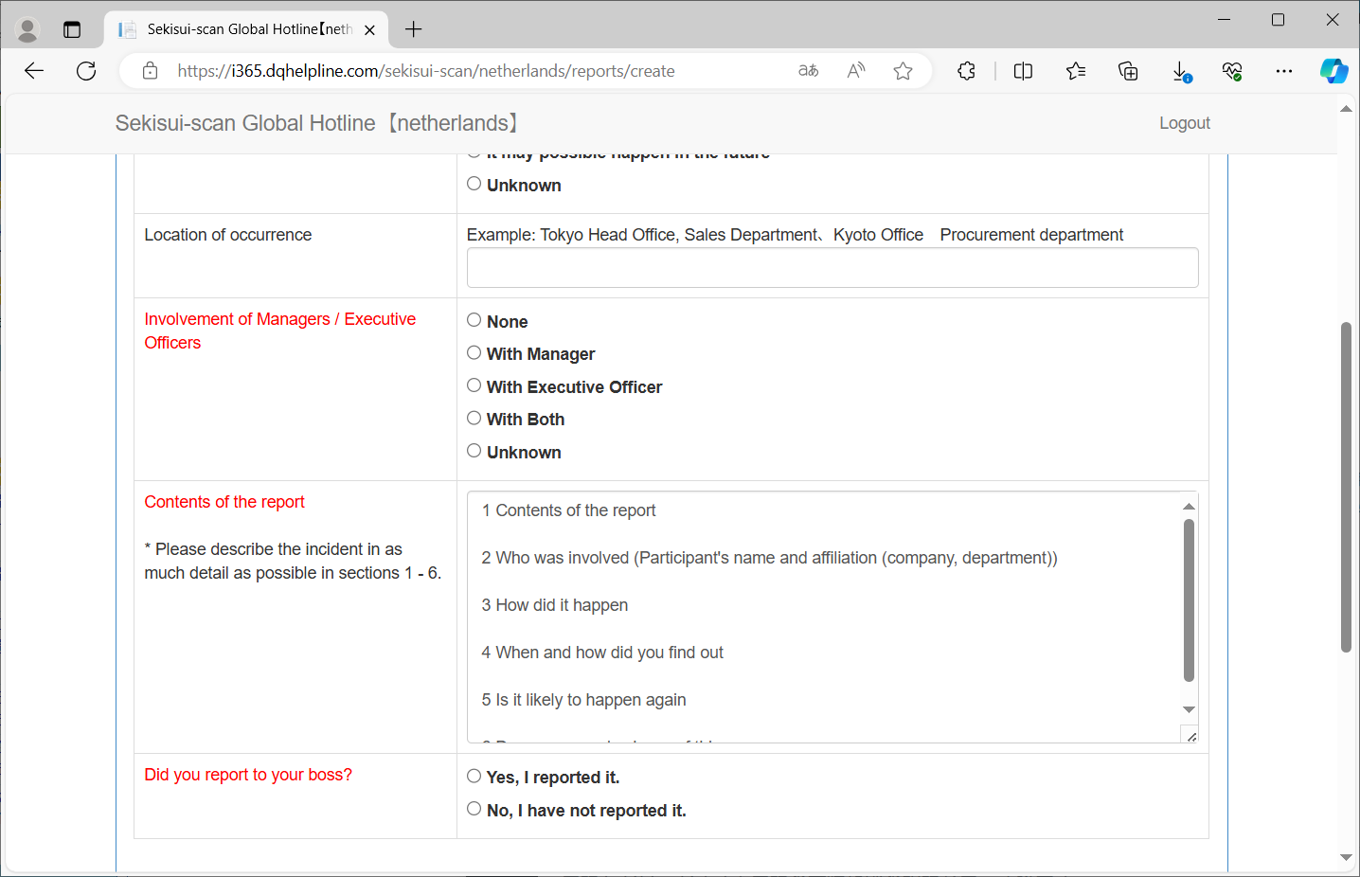
System Interface for Whistleblower - Externals
➉Are managers or executive officers involved?

Slide 13
System Interface for Whistleblower - Externals
⑪Please describe the contents of 1-6 in as much detail as possible.
1 Contents of the report
2 Who was involved
(Participant's name and affiliation (company, department))
3 How did it happen
4 When and how did you find out
5 Is it likely to happen again
6 Does anyone else know of this

Slide 14
System Interface for Whistleblower - Externals
⑫Have you ever discussed this
matter with your boss?

Slide 15
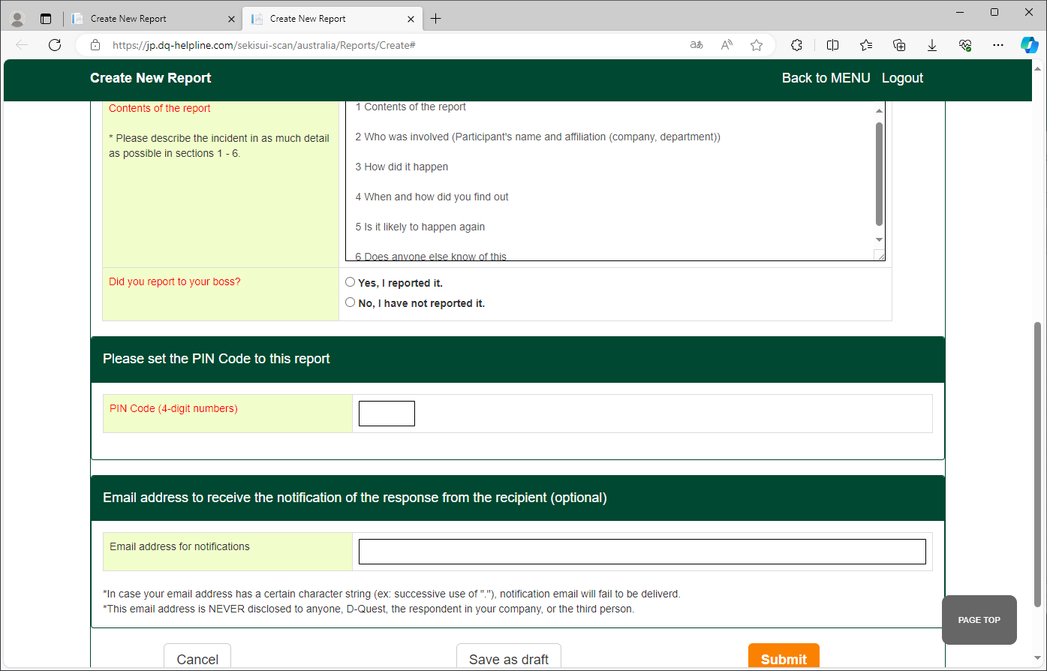
System Interface for Whistleblower - Externals
<During the final check>
⑬If you have a document, file, picture or text/WhatsApp message that supports your report, please upload it via the link below

Slide 16
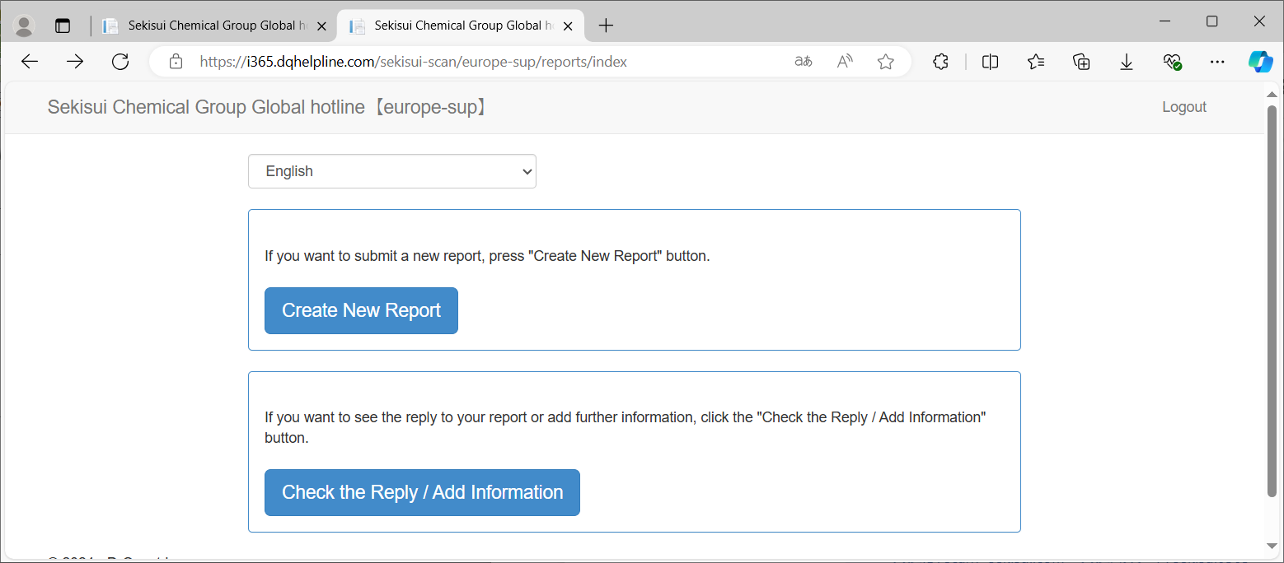
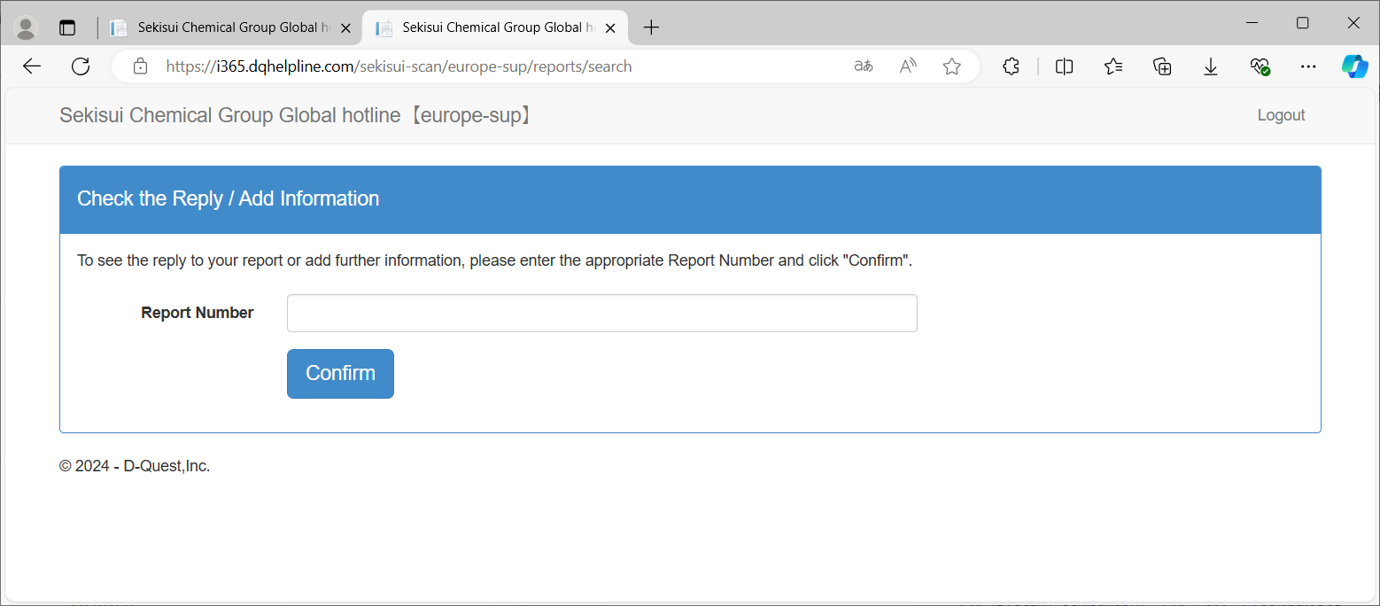
System Interface for Whistleblower - Externals
Check the Reply / Add Information
Report Number

Slide 17
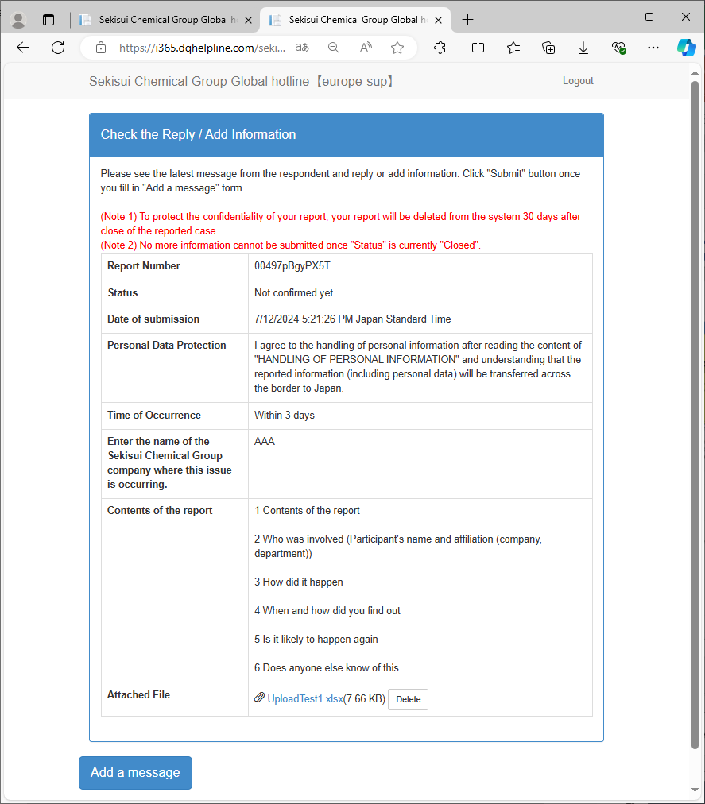
System Interface for Whistleblower - Externals
Files uploaded in the past
If you have a document, file, picture or text/WhatsApp message that supports your report, please upload it via the link below

Slide 18
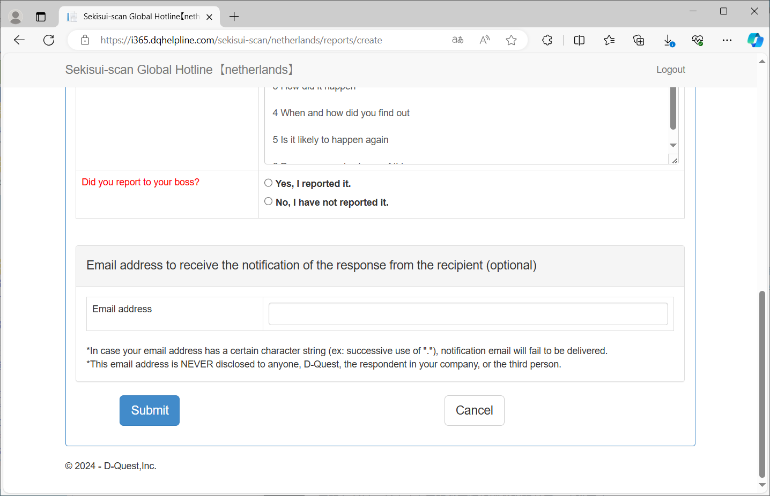
System Interface for Whistleblower - Externals
⑭E-mail address for receiving automatic notification e-mails (option)

Slide 19
System Interface for Whistleblower - Employees
⑭If you wish to report on the above
If you want to cancel the report

Slide 20
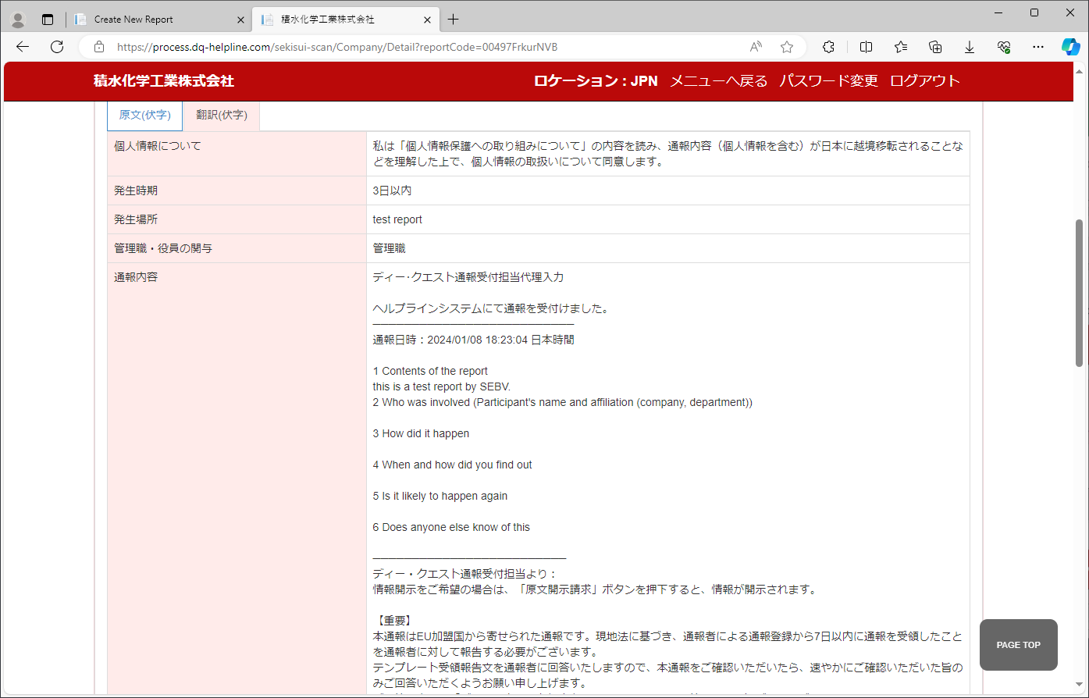
System Interface for Whistleblowing Contact Office
Initial Reporting Details

Slide 21
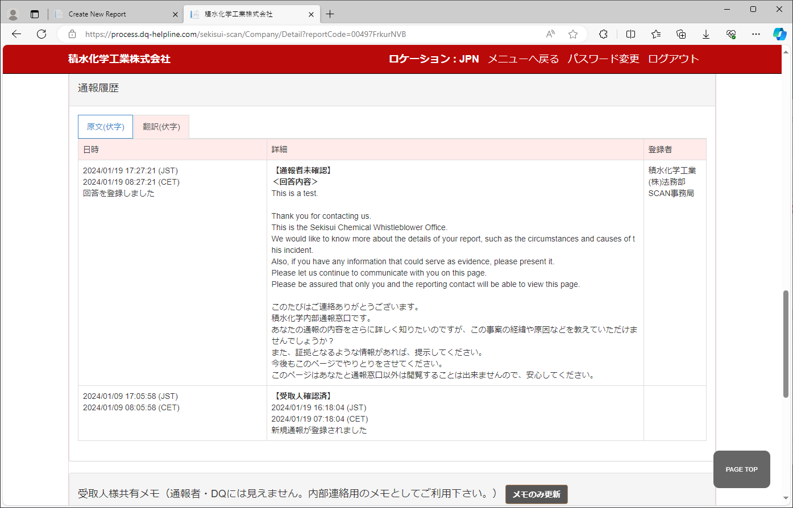
System Interface for Whistleblowing Contact Office
Reply from the Whistleblower Response Office
Thank you for contacting us.
This is the Sekisui Chemical Whistleblowing contact office.
We would like to know more about the details of your report, such as the circumstances and causes of this incident.
Also, if you have any information that could serve as evidence, please present it.
Please let us continue to communicate with you on this page.
Please be assured that only you and the reporting contact will be able to view this page.

Slide 22
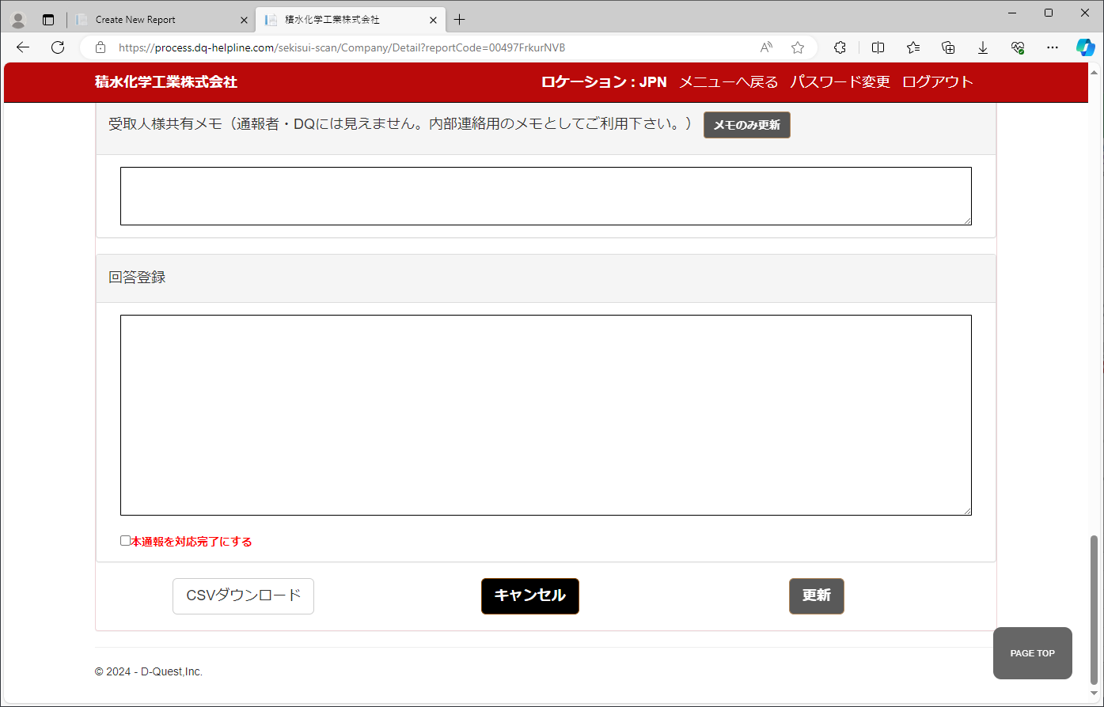
System Interface for Whistleblowing Contact Office
For communication within
the Whistleblowing contact office
Create new reply

Slide 23
Sekisui Chemical Group
Compliance & Risk Management

